Slide 1
CSE 259 - Logic in Computer Science (Spring 2024)
Recitation-1
Waqar Hassan Khan

Slide 2
Slides and Codes
Slides and codes will be available in the Github repository - https://github.com/Waqar-107/ASU-CSE-259-Prolog

Slide 3
How to contact with me
Email: wkhan17@asu.edu
Discord handle: Waqar_107
I check both frequently!

Slide 4
Prolog - resources
Tool we will be using:
GNU Prolog
Useful resources:
GNU Prolog manual
The Prolog Dictionary
Prolog Tutorial - TutorialsPoint
Prolog Tutorial from YouTube

Slide 5
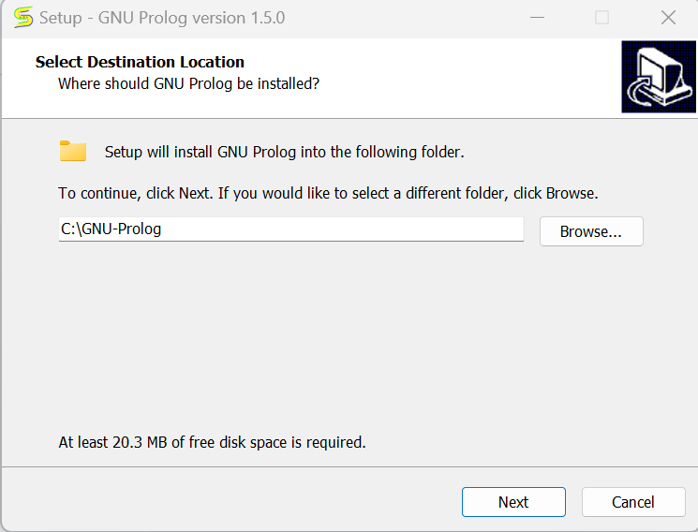
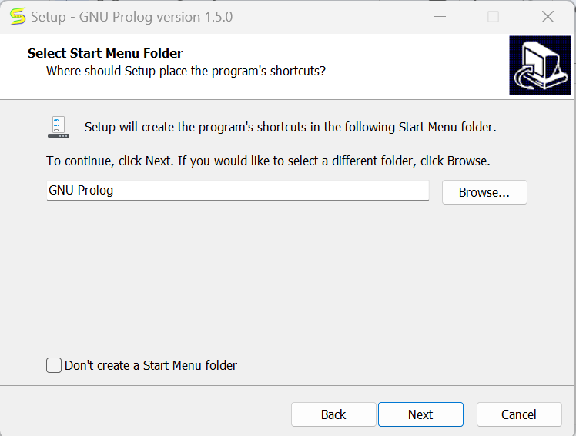
Installation - Windows

Slide 6
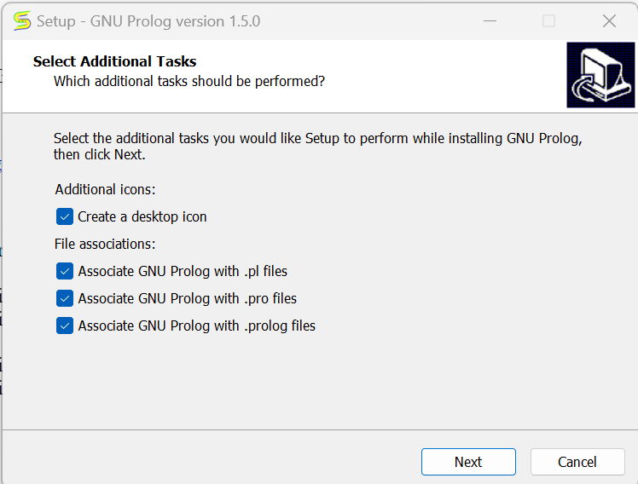
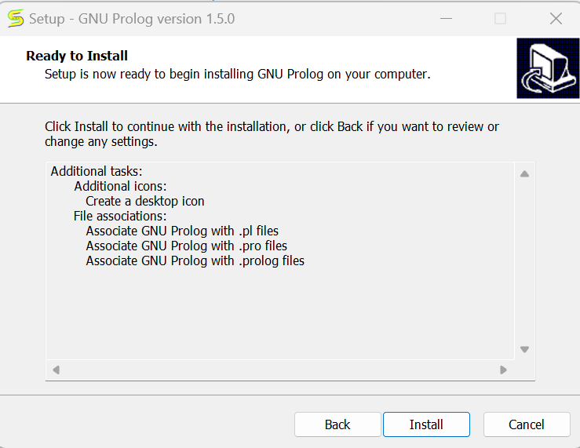
Installation - Windows contd.

Slide 7
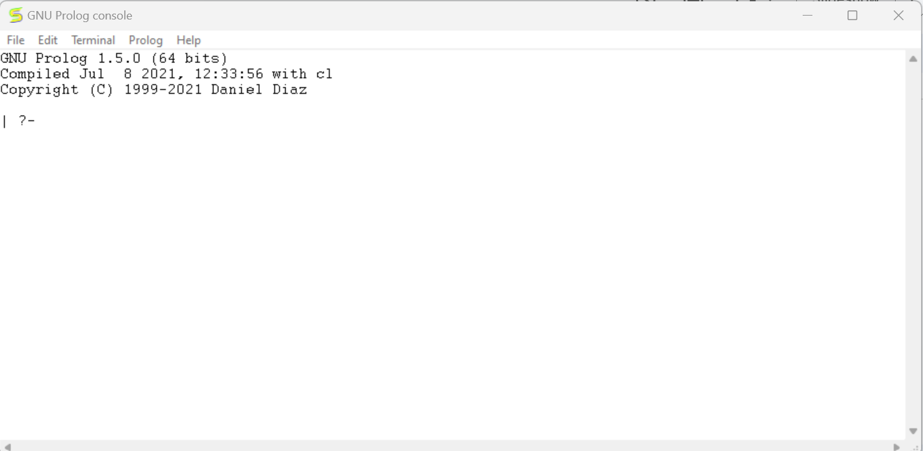
Installation - Windows contd.

Slide 8
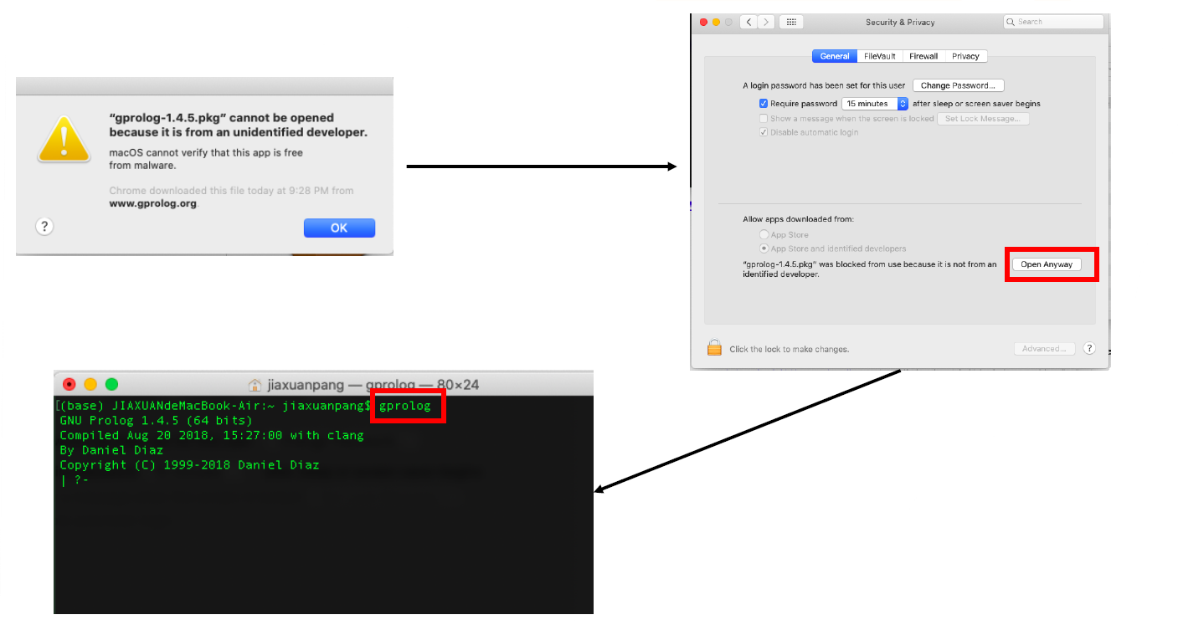
Installation - MACOS

Slide 9
What is Prolog?
Prolog is a logic programming language
Prolog is intended primarily as a declarative programming language
Declarative Programming Language
Declarative programming is when you write your code in such a way that it describes what you want to do, and not how you want to do it. It is left up to the compiler to figure out the how.
Example: SQL, Prolog (Obviously :D)

Slide 10
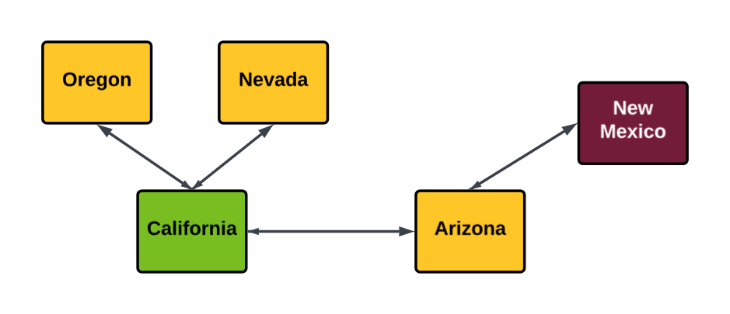
An example
Suppose, we are in California. Which states can we visit from here? (We can travel if the states are adjacent)

Slide 11
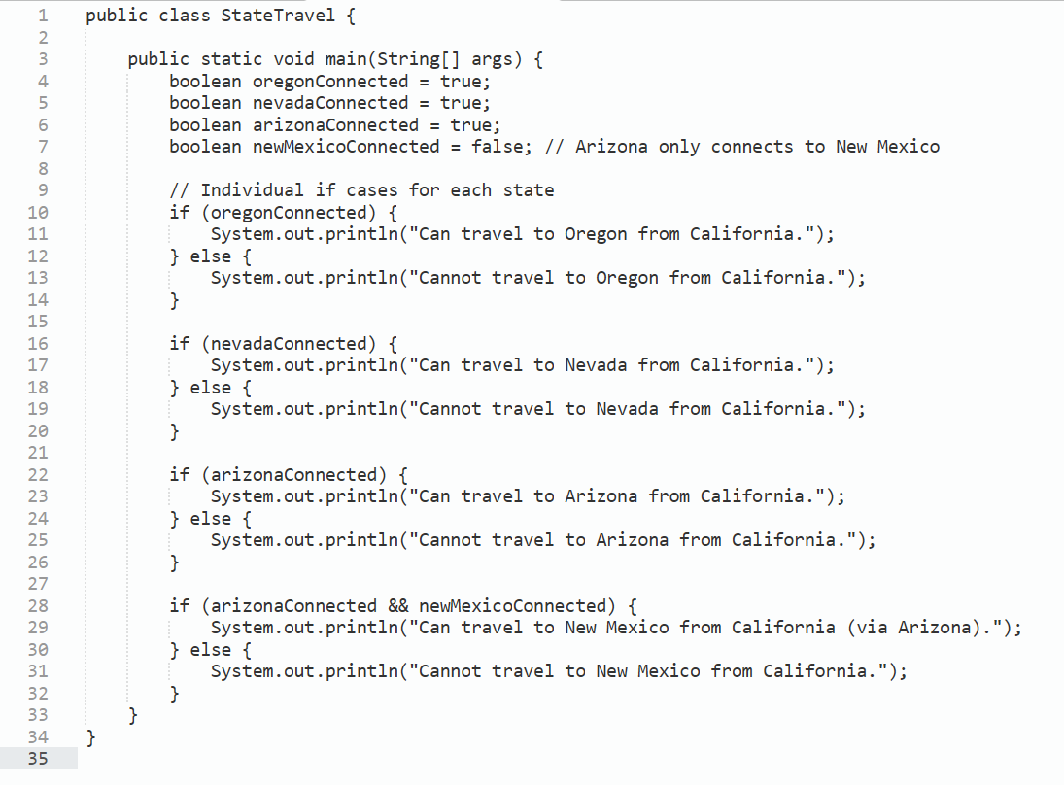
Sample code for the example - Java

Slide 12
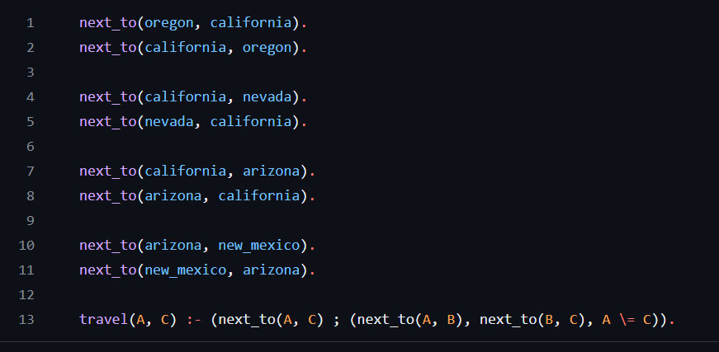
Sample code for the example - Prolog

